Slide 1
Straight Line
Nazmul Kader Chowdhury

Slide 2
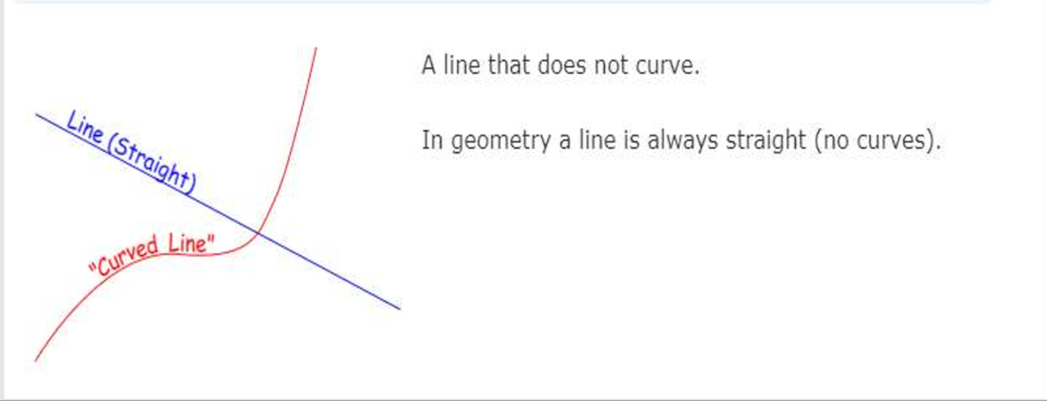
What is a Straight Line?
A straight line is just a line with no curves. So, a line that extends to both sides till infinity and has no curves is called a straight line.

Slide 3
Equation of Straight Line
The relation between variables x, y satisfy all points on the curve.
Y= 2x +4
y+x-4=0
6x-5y+13=0

Slide 4
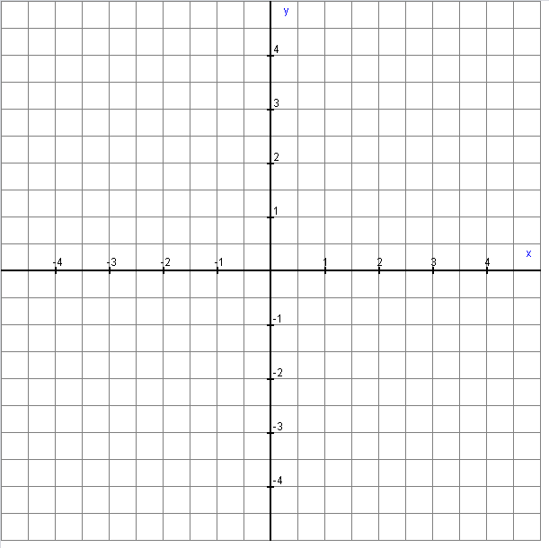

Slide 5
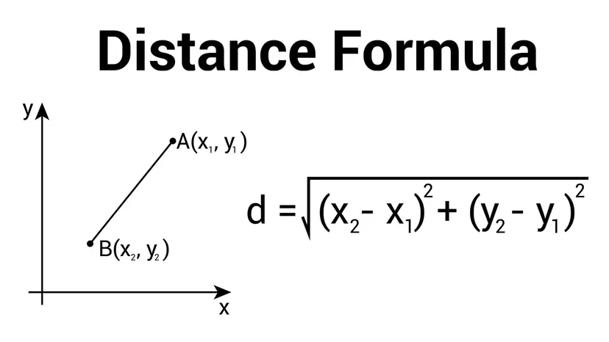
Distance Between Two points

Slide 6
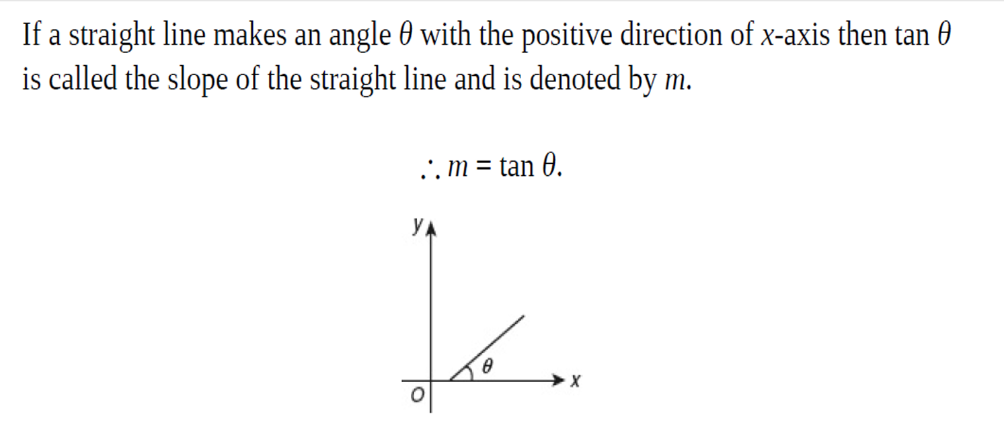
SLOPE OF A STRAIGHT LINE

Slide 7
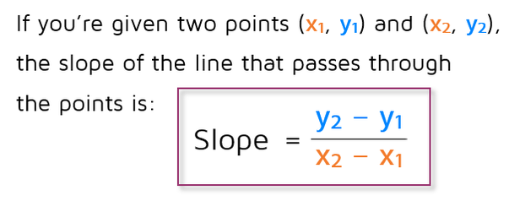
How to Find Slope From Points?

Slide 8

How To MAKE Equation Straight Line?

Slide 9
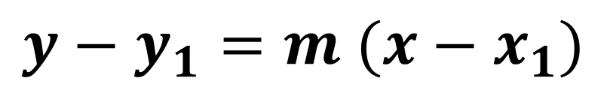
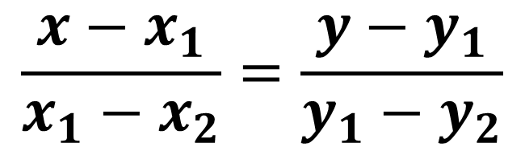
Number 1 rule: If you have two points
$$\frac{x−x_{1}}{x_{1}−x_{2}}=\frac{y−y_{1}}{y_{1}−y_{2}}$$
Number 2 rule: If you have a point and slope
$$y−y_{1}=m (x−x_{1})$$

Slide 10
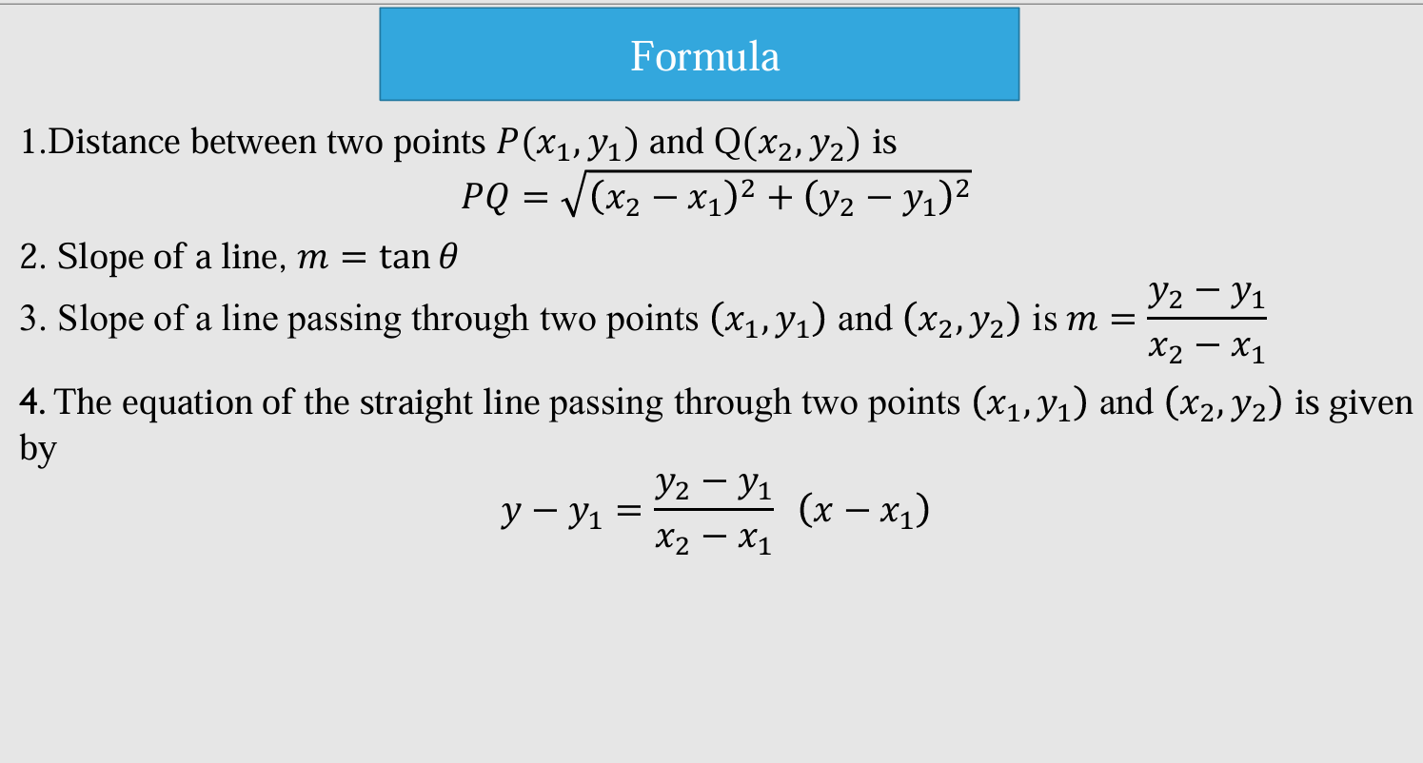

Slide 11
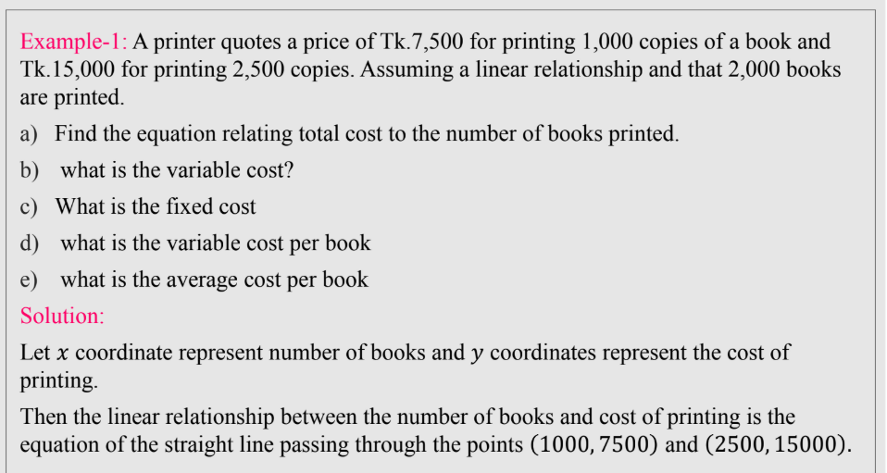

Slide 12
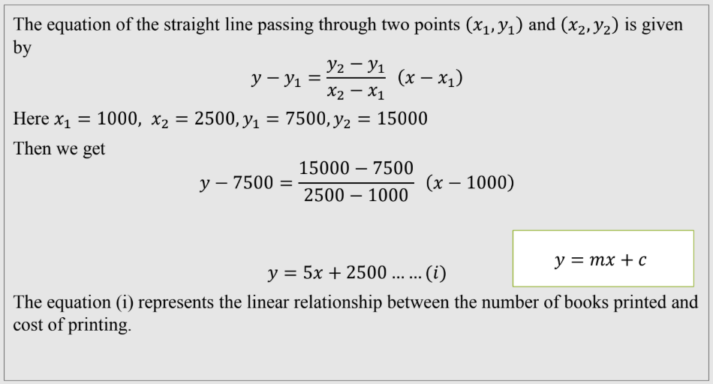

Slide 13
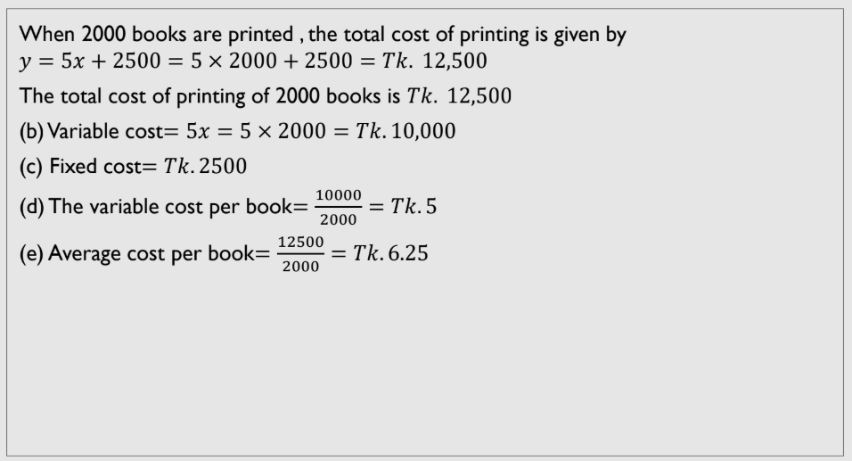

Slide 14
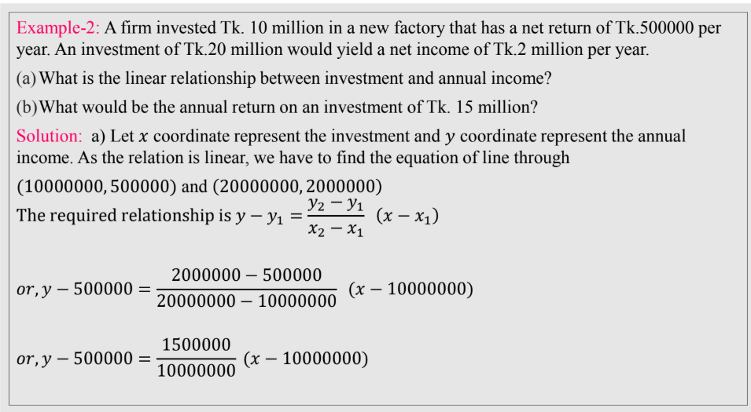

Slide 15
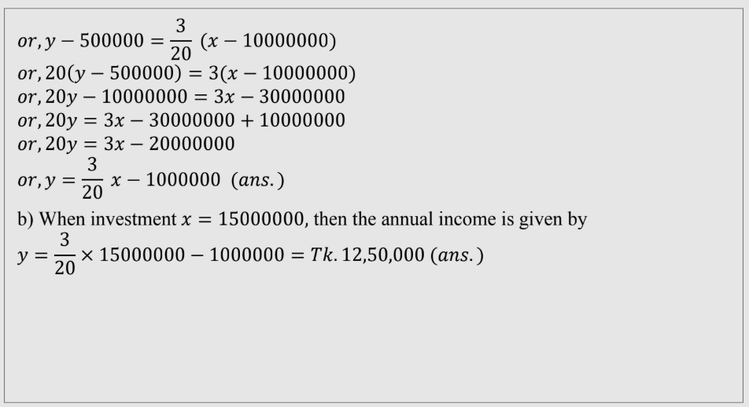

Slide 16
